Slide 1
S-98 update VTC
27th October 2025

Slide 2
Agenda
Introductions
S-164 update
S-98 progress
Document update
Outstanding changes
S100WG
Forward plan
Other Contributions / AOB?
Next meeting

Slide 3
S-164
Dedicated S-164 meeting
Next meeting mid-November
Progress Update

Slide 4
S-98 update – v2.3.0
HSSC Outputs (from circular letter and MS feedback)
Pick Reports (interoperability identifier) from NIPWG / S100WG
ENC PT outputs
Uncertainty (horizontal + vertical)
Submitted comments (Primar)
Data Import rules, portrayal / processing of data (WENDWG)
Other inputs

Slide 5
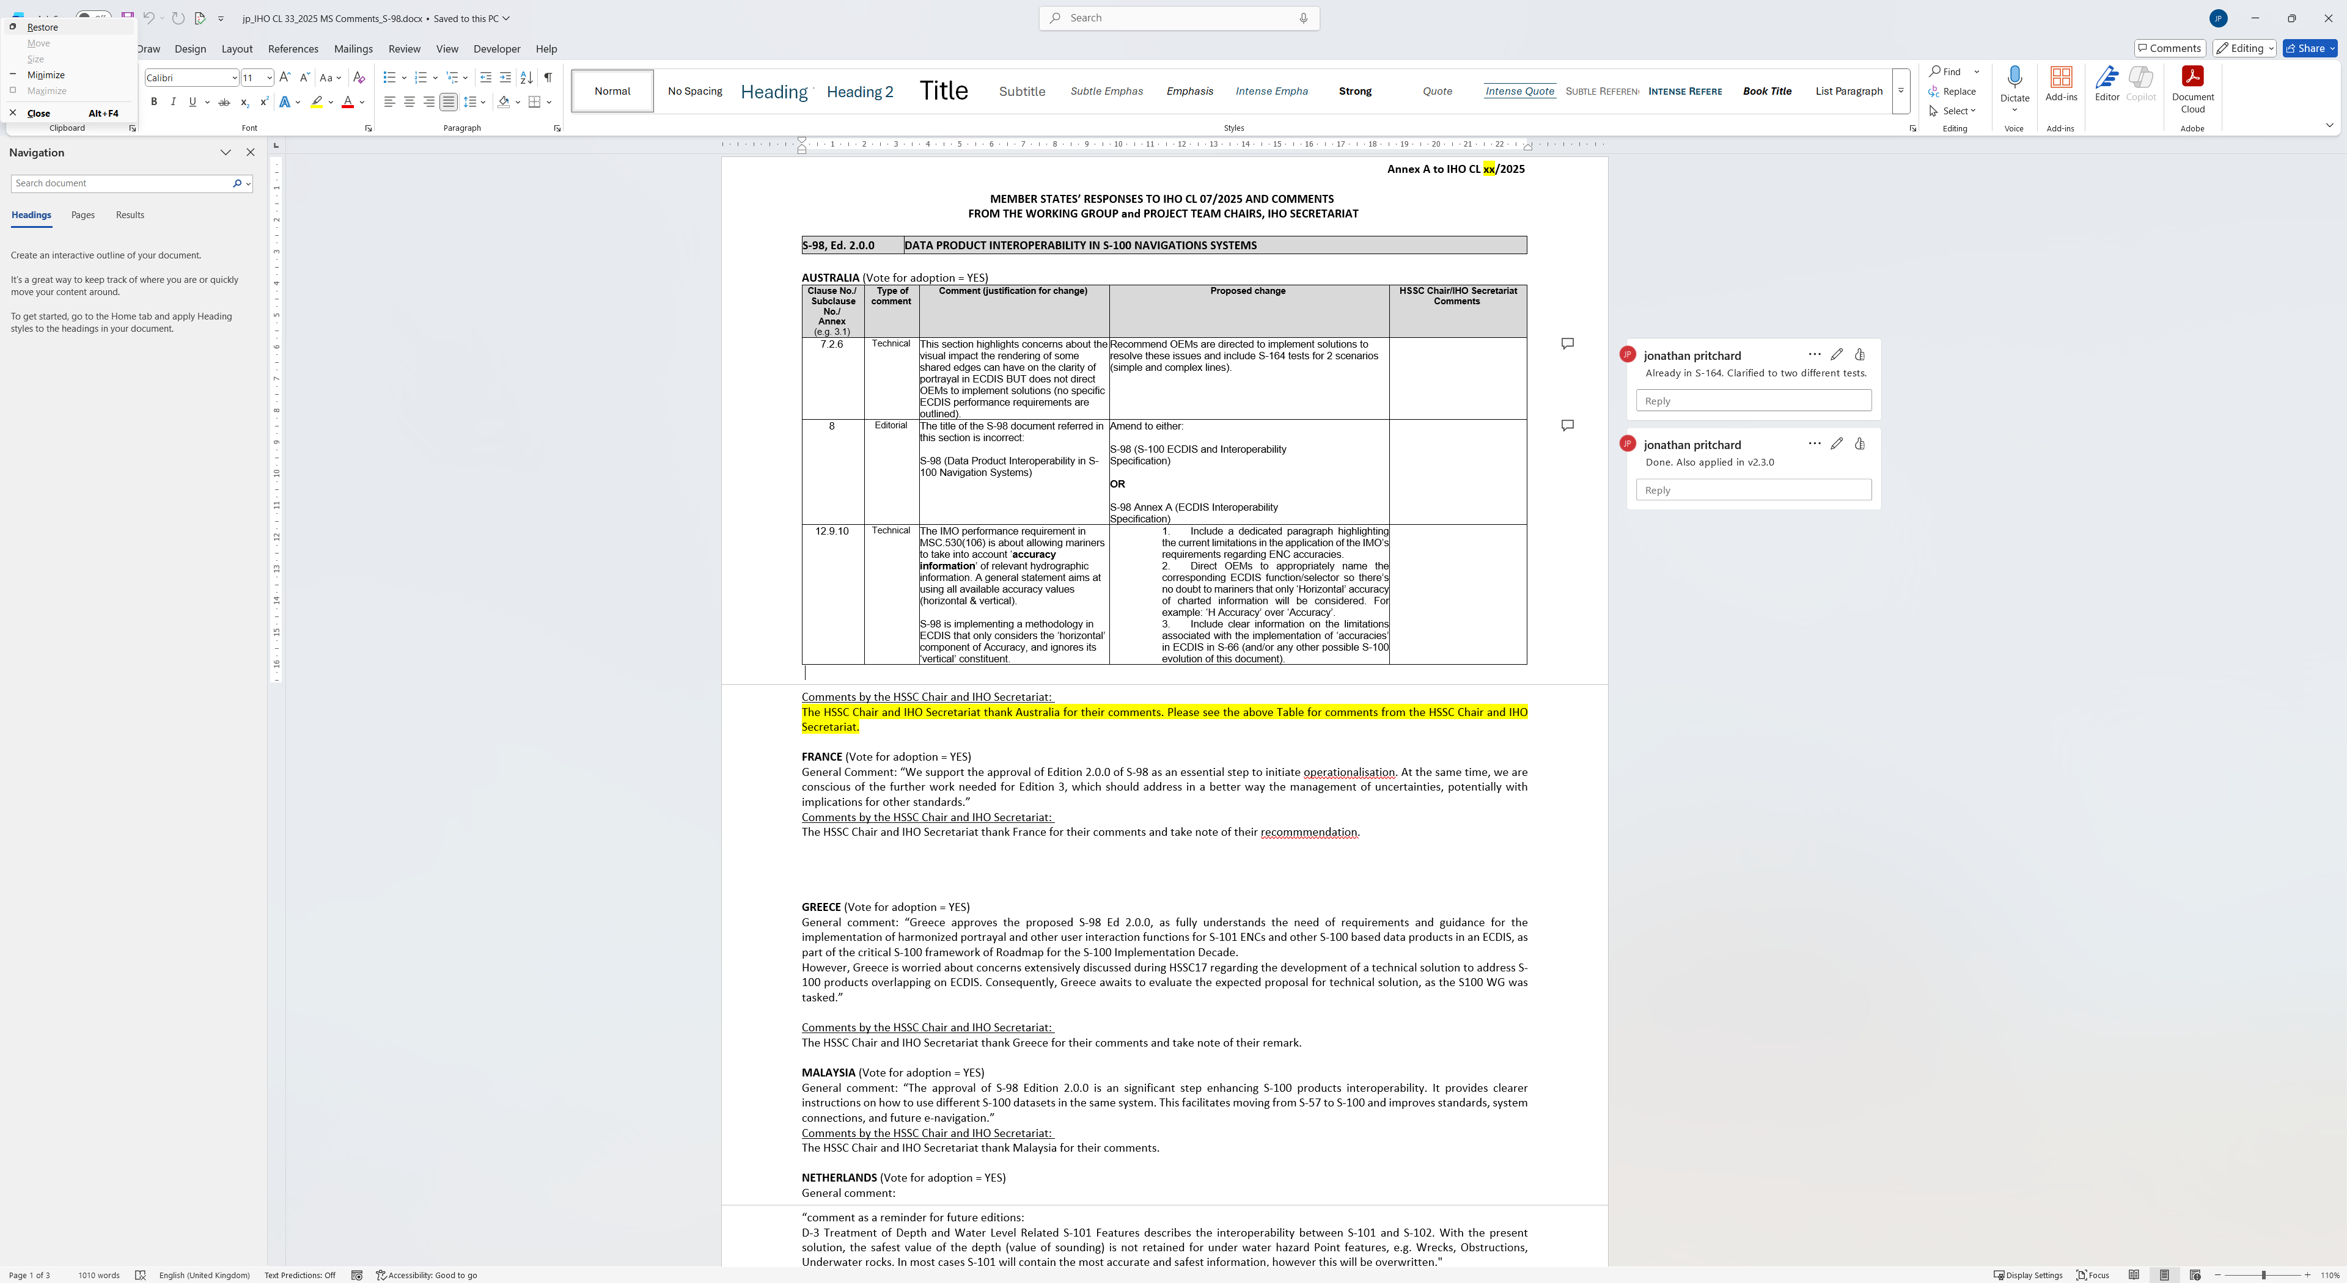

Slide 6
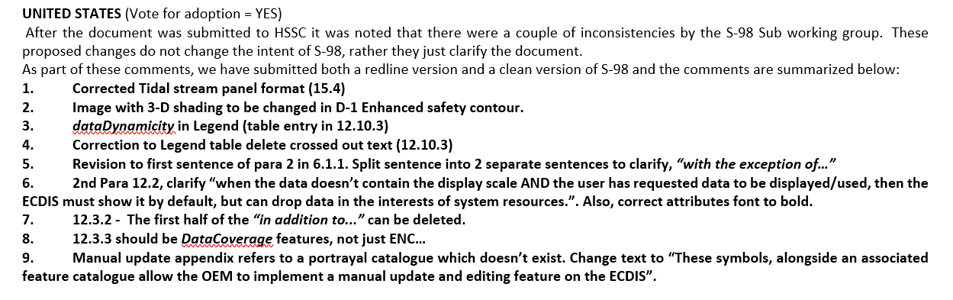
HSSC CL Updates

Slide 7
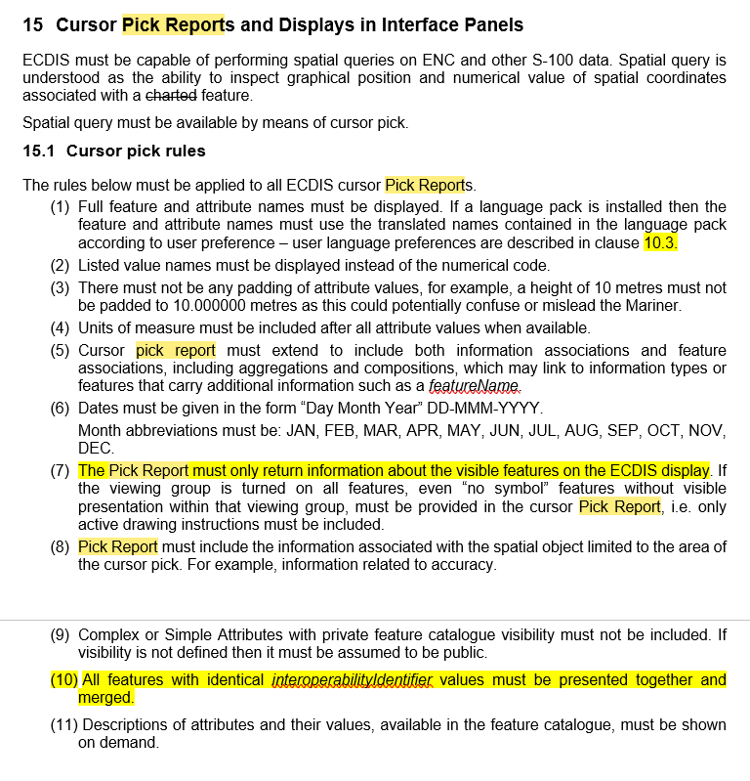
interoperabilityIdentifier and Pick Reports
Current Text – Pick Report
Issue between (7) and (10) as features with identical interopability mechanisms may not be visible (hidden layers, or offscreen, or part of information types)
So, the requirement to return feature about visible features could be a minimum requirement by deleting word “only” in (7).
(10) can then add interoperabiltiyIdentifier features to the pick report

Slide 8
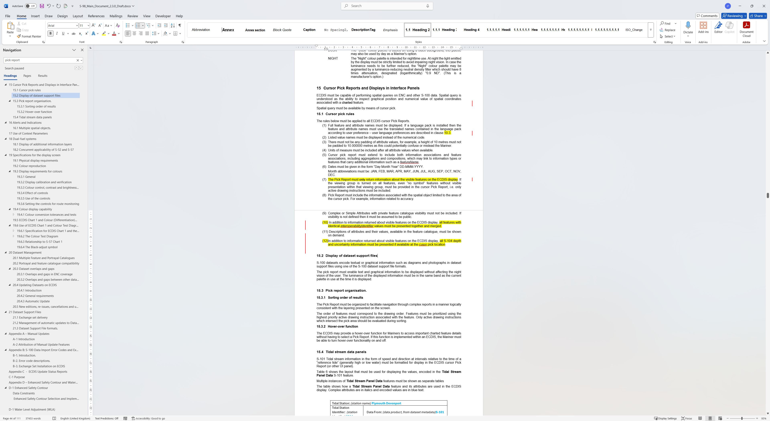
interoperabilityIdentifier and Pick Reports
Current Text – Pick Report
Issue between (7) and (10) as features with identical interopability mechanisms may not be visible (hidden layers, or offscreen, or part of information types)
So, the requirement to return feature about visible features could be a minimum requirement by deleting word “only” in (7).
(10) can then add interoperabiltiyIdentifier features to the pick report

Slide 9
Proposal to enable Pick Reports for S-104
See Pick Report text from S-98
S-104 is never displayed. It is only used for WLA and only in areas where there is also S-102 data.
So, the user can not interrogate the actual water level values
Proposal is to always return S-104 values (water level and any vertical uncertainty) when interrogating a location where installed S-104 data exists.

Slide 10
ENC PT outputs / questions?
ENC PT:
“S-101PT Chair/Secretary to report to (S-100WG) S-98 Sub-Group to initiate the investigation of a solution for improved ECDIS functionality for taking into account ENC accuracies.” – ref paper from last meeting on uncertainty
“S-101PT Chair/IHO Sec to make the S-98 Sub-Group Lead aware that a proposal for the inclusion of a new attribute in S-101 to allow for dynamic bridge clearance heights to be incorporated into water level adjustment functionality in S-100 ECDIS is being considered by the S-101PT”
Propose adding in a statement to the effect that WLA adjustment of heights may be done when S-101 data structure supports it but should be considered optional until that time
Also :
Algorithm – add in a statement to clarify that there is no requirement to display ENC data at a smaller scale than minimumDisplayScale.
This is a consequence of the algorithm, not a new requirement

Slide 11
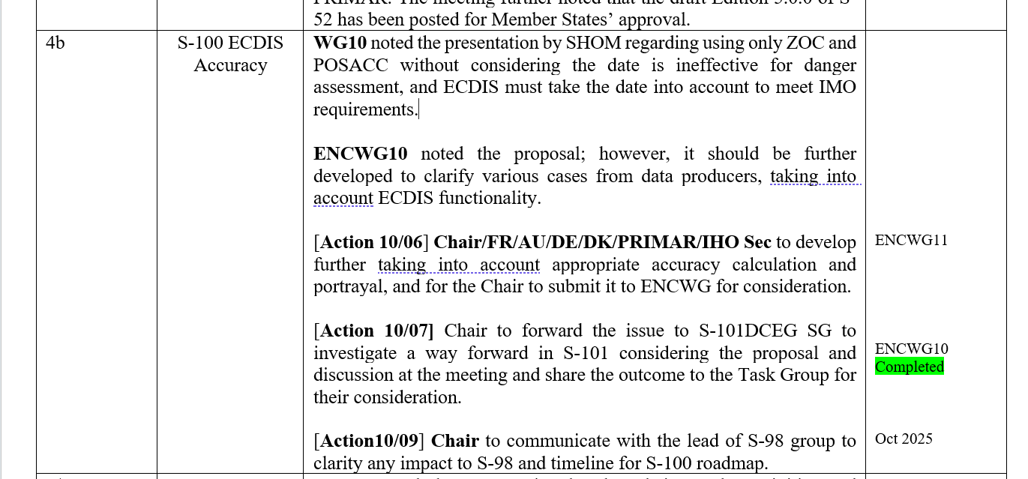
S-98 should be drafted for review by the end of the year, it's due to go to HSSC next year for approval so any changes need to be proposed and accepted before the end of the year. My comments on the paper were:
It’s VERY late to alter the algorithm. But it could be done - we would need an explicit set of new text to go into S-98 clarifying how it should work on ECDIS which can be proposed and accepted by the S-98 group. Also, if there are testing impacts they need to be drafted for S-164
The point raised is a good one, that updates later than the survey date can't necessarily inherit the CATZOC values so the algorithm will show more false positives than actually exist.
Too many false positives, however (in my opinion) are not necessarily a problem. False Negatives (i.e. showing something as more safe than it is) must be avoided at all costs, so leaving the algorithm as it is just makes it less effective (and there's plenty of those concerns already).
The user can turn it off, so I'm less worried about it
Any changes need to be simple enough to implement. If we can do this, the group is more likely to accept any changes.

Slide 12
Vertical Uncertainty
Proposal to add vertical uncertainty to 12.9.10 “Indications related to ENC Accuracy” and related sections
This would add verticalUncertainty values to calculations when ESC and WLA are switched on, when the user selects “take quality into account”
Initial reactions from implementers are in support.
We need a name for the “data quality taken into account” selector.
Suggest “Uncertainty Applied” or “Uncertainty”, “Data Uncertainty”? Thoughts? [NOT accuracy]
Minimum could be applied, optionally split into vertical and horizontal?
Data accuracy selector | Products | Uncertainty applied
Off | S-57 or S-101 alone | Uncertainty not applied
On | S-57 or S-101 alone | Horizontal uncertainty applied from S-57 or S-101
On | S-101 + S-102 (ESC) | Horizontal uncertainty applied from S-101 together with vertical uncertainty from S-102
On | S-101 + S-102 + S-104 (WLA) | Horizontal uncertainty applied from S-101 together with vertical uncertainty applied from S-102 and S-104

Slide 13
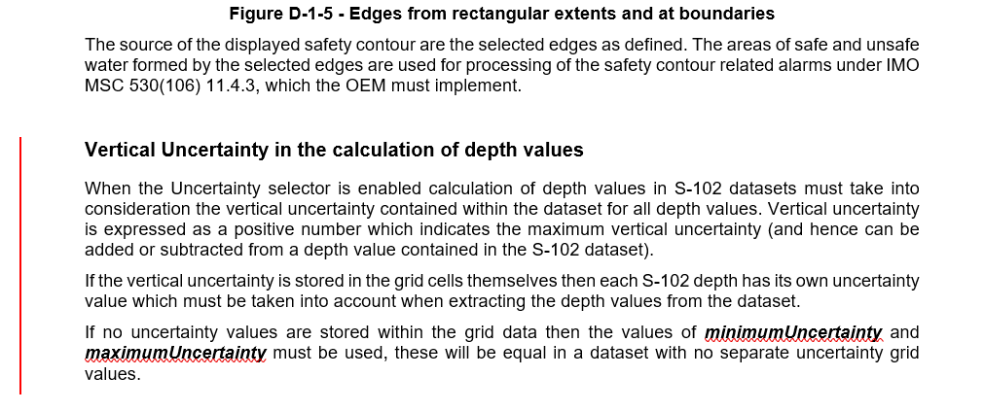
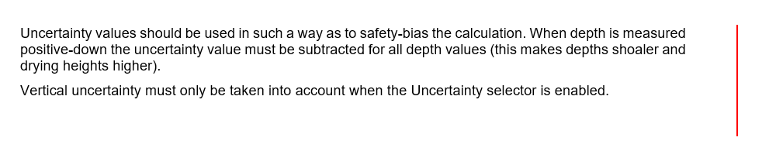
Vertical Uncertainty
Requirement to call selector “Uncertainty” added
Vertical uncertainty added to all calculations in ESC and WLA when Uncertainty selector is enabled.
Data accuracy selector | Products | Uncertainty applied
Off | S-57 or S-101 alone | Uncertainty not applied
On | S-57 or S-101 alone | Horizontal uncertainty applied from S-57 or S-101
On | S-101 + S-102 (ESC) | Horizontal uncertainty applied from S-101 together with vertical uncertainty from S-102
On | S-101 + S-102 + S-104 (WLA) | Horizontal uncertainty applied from S-101 together with vertical uncertainty applied from S-102 and S-104

Slide 14
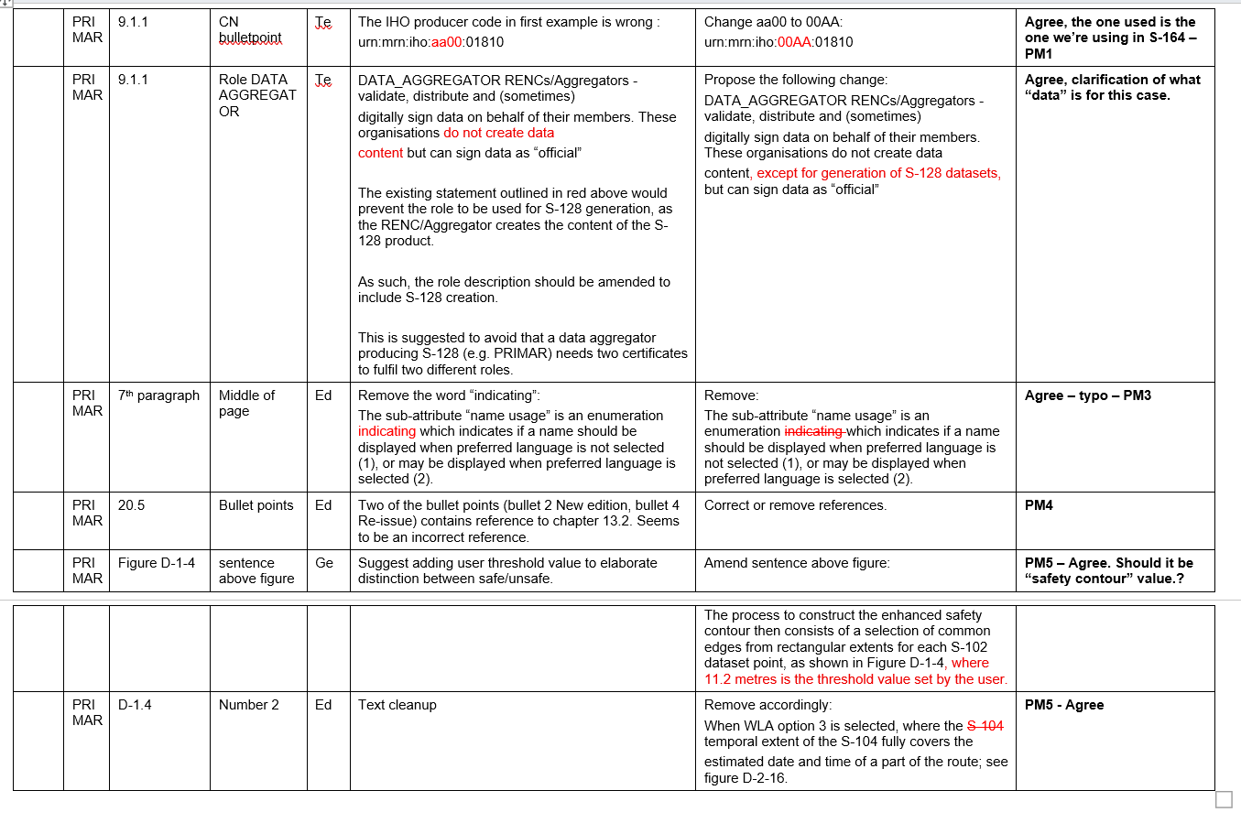
Primar Comment Sheet.

Slide 15
Data Import Rules
When should data be loaded, and if it is, is it marked with the “non-official” border?
Current Rules – in S-98
All certificates must be “valid”, correct format and not expired
All certificates must be authenticated by the scheme administrator
All signatures must be valid. If they are not valid the dataset they sign must not be installed
All catalogues (Feature and Portrayal) must be signed by the Scheme Administrator to be installed
All datasets are marked with the unofficial border unless the role field in the certificate =
DATA_PRODUCER
DATA_AGGREGATOR
Dataset is S-128 and role=AGGREGATOR
The “id” data producer integer and alpha code elements in the MRN of at least one of the authenticating certificates must match those contained in the dataset and its CATALOG.XML entry.
Is there still a requirement for “unofficial data installation” – we think so.
Should unofficial data installs be “warned about” using an SSE code?
WEND WG – Proposal to cover “what overlaps what?”
Role = SCHEME_ADMINISTRATOR
SA Root Certificate
Subject=urn:mrn:iho:GB00:00540
(DS) Certificate
Issuer=IHO
Role=DATA_PRODUCER
Signature
Dataset
id=GB00,00540

Slide 16
Data Import Rules Proposal
(Add to current rules in S-98)
All ENC Data is loaded according to the algorithm (Appendix E)
Non-ENC Data is only used (portrayed/processed) when MSVS is between the values specified in CATALOG.XML for minimumDisplayScale and maximumDisplayScale
Propose to add to this:
Non-ENC data must only be portrayed over ENC data if:
The data producer of the Non-ENC data is the same as the data producer of the ENC data; or
The ECDIS has imported a certificate issued by the ENC producer with the Non-ENC data producer as its Subject.
Role = SCHEME_ADMINISTRATOR
Role = SCHEME_ADMINISTRATOR
SA Root Certificate
SA Root Certificate
id=urn:mrn:iho:GB00:00540
id=urn:mrn:iho:GB00:00540
Certificate
Certificate
role
role
Signature
Signature
ENC Dataset
id=XY00,00378
Non-ENC Dataset
id=AB00,00493
overlaps
Subject=urn:mrn:iho:AB00:00493
Certificate
Issuer= urn:mrn:iho:XY00:00378
Role=DATA_PRODUCER

Slide 17
Other inputs (September / October 2025)
IALA proposal
Add S-421 to list of PS documented in S-98
WLA adjustment of heights may be done if S-101 supports it in the future but for now should be optional [Affects the wording of S-101 – clarify]
Fields need to be specified in S-128 / Update Status Report
Is temporal overlap and spatial overlap related. We should clarify that “overlap” of S-104 datasets is spatio-temporal, not just spatial.
Clarify cancellation rules and data constraints (CATALOG.XML and datasets)
Github repository tidied up issues. 25 remaining.
S-124 update

Slide 18
Inputs from IALA on v2.2.0
Clause 2.1:
Todo: Include IEC 63173-1 as normative reference
Reasoning: S-421 is the format to be used for several processes in an ECDIS. The format is specified in IEC 63173-1
Suggestion: new element in the list: «IEC 63173-1 Maritime navigation and radiocommunication equipment and systems - Data interfaces - Part 1: S-421 Route Plan based on S-100»
Clause 6.1.1:
Todo: Include S-421 as product specification
Reasoning: S-421 is the product specification, to bring in a route plan from an external actor, and also to establish a route plan ready for export to external actors. Elements may differ from the internal route format and mariner must have easy access to which elements are part of the route plan to exchange.
Suggestion: new bullet point in the list: «S-421 Route Plan, for exchange of a route plan». Eventually also of value to refer here give reference to later clauses in the S-98 document under this bullet point, for example clause 9.2.1.
Clause 6.1.3:
Todo: Include S-421 in the list
Reasoning: The product type S-421 is to be utilized for several purposes. A Route plan sent from back of bridge to front of bridge. Exchange with pilots from their portable pilot units or ECDIS’s. Route exchange ship-shore. Plus a high possible value to include S-421 as element of ENDS. The portrayal is defined in IEC 61174 / IEC 63173-1, in connection with the processes route planning and route monitoring.
Suggestion: New bullet point: ‘- IEC S-421 Route plan’
Clause 9.2.1:
Todo: Evaluate if an extra line can cause better guidance
Reasoning: The route plan consists of waypoints, legs and action points, and all of these including to some degree labels, will always display over the given data layers when a route is being planned or used for navigation (under monitioring) in the ECDIS. A sentence here can also be referred to in 6.1.4 «Data layers in Display base and Standard Display» to better explain that the route plan is a separate element (data layer!) handled differently than all other data layers.
Suggestion: Evaluate if a sentence can be included in the end of the second paragraph after «… in ther list below:». Suggested sentence: «The route plan including waypoints, legs, cross track zones and action points will have priority over these».

Slide 19
Forward plan – questions?
Please read through and send further comments for next VTC
VTC November
Possible F2F December (tbc by end October)
S-98 to be submitted for review by PT end December,
On to S100WG for review
Adjudication of comments prior to TSM – TSM for final adjudication and forwarding to HSSC 2026

